Slide 1
APAC SIP on ASBU B0-FICE AIDC Implementation Seminar Standard OLDI Communication Lessons learned in Europe
ICAO EUR/NAT Office
Celso Figueiredo – Regional Officer ANS - ATM
Bangkok, Thailand
28 to 31 October 2014

Slide 2
By the end of the Presentation you will have a:
The background of the OLDI implementation in Europe;
An overview of SYSCO standard co-ordination;
Understanding of SYSCO terminology;
Challenges faced by the European States;
Current status of OLDI messages implementation plan.

Slide 3
Overview
Flights which are being provided with an ATC service are transferred from one ATC unit to the next in a manner designed to ensure complete safety;
In order to accomplish this objective, it is a standard procedure that the passage of each flight across the boundary of the areas of responsibility of the two units is co-ordinated between them beforehand and that the control of the flight is transferred when it is at, or adjacent to, the said boundary.

Slide 4
Background, early 1980’s
Where it is carried out by telephone, the passing of data on individual flights as part of the coordination process is a major support task at ATC units, particularly at Area Control Centers (ACCs);
The operational use of connections between Flight Data Processing Systems (FDPSs) at ACCs for the purpose of replacing such verbal "estimates", referred to as On-Line Data Interchange (OLDI), began within Europe in the early nineteen eighties.

Slide 5
Background, early 1980’s
Common rules and message formats were elaborated and agreed by the agencies concerned and incorporated in Edition 1 of the EUROCONTROL Standard for On-Line Data Interchange;
This document, Edition 4.2, has been produced to meet new evolving service requirements and to incorporate feedback from the implementation of earlier versions.

Slide 6
System Supported Coordination (SYSCO) Implementation
(Electronic coordination (SYSCO) using OLDI messages)
Ground to ground electronic coordination, known as System Supported Coordination (SYSCO), supports coordination dialogue between controllers and transfer of flights between ATSUs and permits controllers to conduct coordination screen to screen between adjacent units/sectors with less risk of misunderstanding and less need for repetition.

Slide 7
System Supported Coordination (SYSCO) Implementation
(Electronic coordination (SYSCO) using OLDI messages)
SYSCO reduces the workload associated with coordination, integration and identification tasks, and facilitates early resolution of conflicts through improved inter ATSU/sector coordination.
Following the definition of standards for On-Line Data Interchange (OLDI) the concepts and functions for electronic coordination were further developed by a SYSCO Task Force in the early 1990’s.

Slide 8
System Supported Coordination (SYSCO) Implementation
(Electronic coordination (SYSCO) using OLDI messages)
Under the European Commission Implementing Rule, electronic coordination using a limited number of OLDI messages for notification, coordination and transfer of flights becomes mandatory with effect from 31 DEC 2012.
The SESAR Implementation Package 1 (IP1) goes further and recommends a larger scope.
In addition the OLDI messages associated with transfer of data link equipped aircraft will need to be implemented as CPDLC becomes mandatory since 2013 (western and central Europe) and 2015 (eastern and northern Europe).

Slide 9
Challenges faced by the States
How OLDI/SYSCO would be implemented and be handled by the systems in place today?
In this context problems linked to data consistency and coherence will become apparent.
Definition of the Operational Scope.
Notification of flights approaching a flight information region (FIR) boundary;
Coordination of boundary-crossing conditions; and
Transfer of control; and
Definition of the operational requirements.

Slide 10
Challenges faced by the States
Specification of peer to peer messages including the rules for processing, content, format;
Put in place a detailed operational trials:
Define the KPI Objectives for trials;
Example: The provision of information on traffic within the area of interest but not entering the controller’s area of responsibility was not considered, in some cases, beneficial for the situations prevailing during the trials;

Slide 11
Challenges faced by the States
The exchange of data is based on the same communications solution whether it is civil-civil or civil-military;
ANSPs, Military, potential Airport Authorities are responsible for software development and physical deployment of leased line or networks.

Slide 12
Challenges faced by the States
What should be covered?
Covers:
Notification
Co-ordination
Transfer of control and transfer of communications
Pre-departure co-ordination
Civil-Military co-ordination
Support to air-ground data link for forwarding of log-on parameters; and
Includes possibility of dialogue procedure

Slide 13
Current OLDI status
OLDI Survey conducted in 2006 shows that:
Almost all European ACCs have OLDI links with their neighbours;
Some OLDI links to North Africa;
Basic co-ordination messages widely implemented (notification and initial co-ordination);
Some transfer messages implemented;
Terminal areas have OLDI facilities in busy environment;
Wider implementation of transfer messages and dialogue procedures.

Slide 14
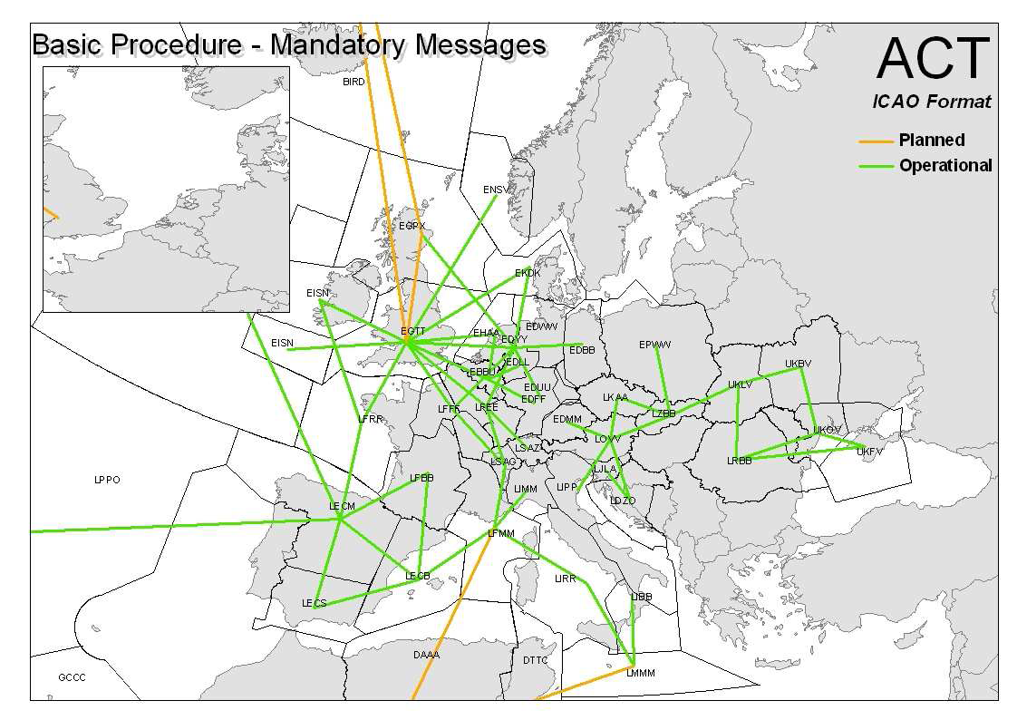
Current OLDI status – Survey example

Slide 15
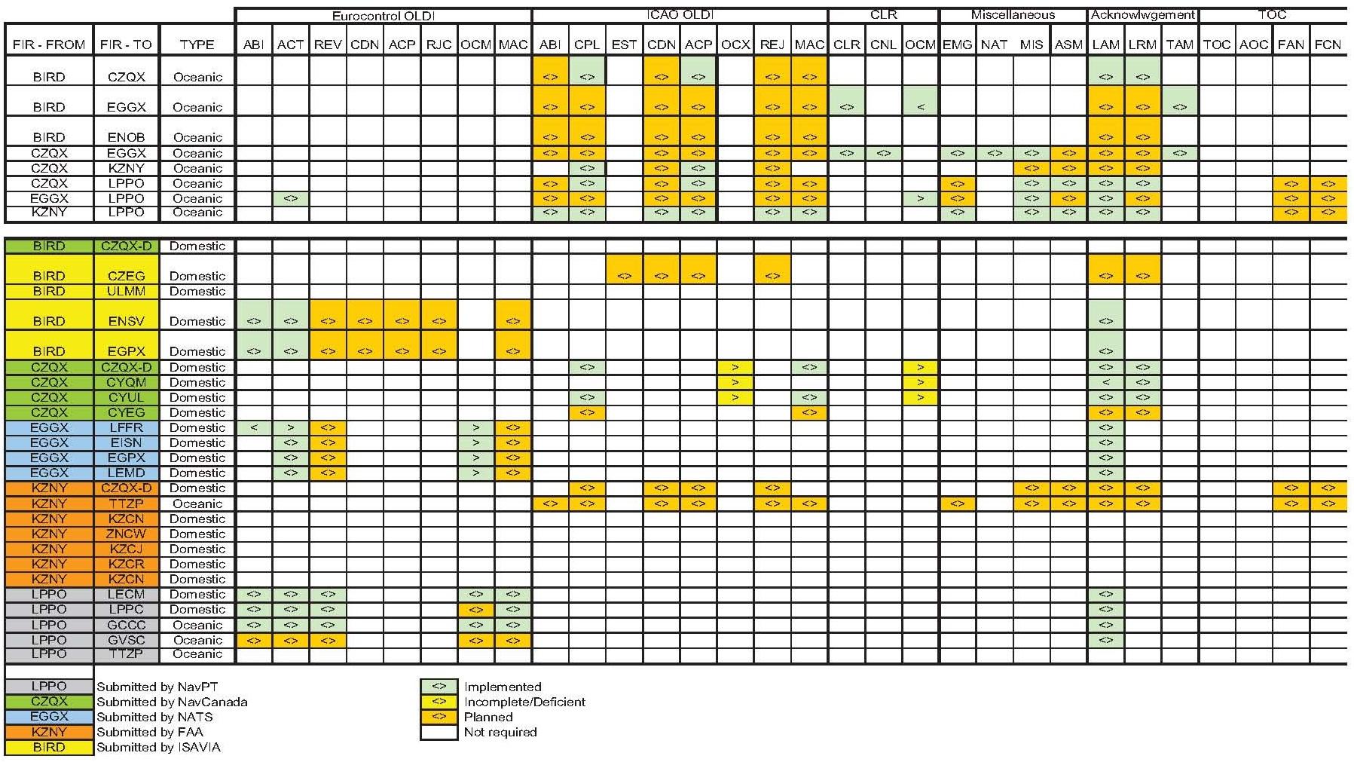
Current OLDI status
AIDC

Slide 16
EUR candidates to connect with ICAO APAC Region
Russian Federation
Europe

Slide 17
That completes:
Standard OLDI Communication Lessons learned in Europe

Slide 20
Current OLDI status in NAT Region
NAT SPG Conclusion 45/25 - Implementation of Air Traffic Services (ATS) Inter-Facility Data Communication (AIDC) throughout the NAT Region, That:
all States make arrangements to fully implement AIDC, including the re-negotiation function, by 15 November 2012;
the NAT Implementation Management Group (NAT IMG) oversee the development of a detailed implementation plans to assist Air Navigation Service Providers (ANSP) to meet the 15 November 2012 date;

Slide 21
Current OLDI status in NAT Region
c) the NAT IMG direct its contributory groups to assist in the development of a harmonized multi-regional AIDC Interface Control Document (ICD);
d) the NAT Safety Oversight Group keep under review the impact that the gradual implementation of AIDC may have on reducing risk; and
e) the NAT SPG be provided with regular progress reports.

Slide 22
Current OLDI status Inter-Regional TF
As a result of the ongoing endeavor to harmonize Air Traffic Service Inter-facility Data Communications (AIDC) and consolidate the Interface Control Document (ICD) for the North Atlantic (NAT) and Asia/Pacific (APAC) Regions, the ICAO Inter-regional AIDC Task Force (IRAIDCTF) was formed and its first meeting was held from 16 to 18 January 2013 at the ICAO EUR/NAT Office in Paris, France.

